Slide 1

Factory Automation Overview
By: Joshua.Wang

Slide 2
Objectives
What is Factory Automation
Components in Factory Automation
Review IA products that are used in Factory Automation
Gain better understanding of the solution needs in Factory Automation

Slide 3
Key Trends
Drive to more energy efficient systems
Expanding competitive situation world wide is driving need for increase productivity, quality and throughput (need better / finer control)
Increased diagnostics to reduce maintenance and down time
Increase adoption of wireless for non critical applications

Slide 4
Industrial Automation
Major Industry Segments:
Manufacturing
Pharmaceutical Manufacturing
Consumables Manufacturing
Automotive Manufacturing
Material Handling
Process
Refining
Chemical
Food & Beverage
Pulp and Paper
We Focus Areas
PLCs (programmable controller and I/O modules)
CNC or Robot
Embedded computer board
Sensors / Measurement Equipment
Motor control
Motion control
Machine vision

Slide 5
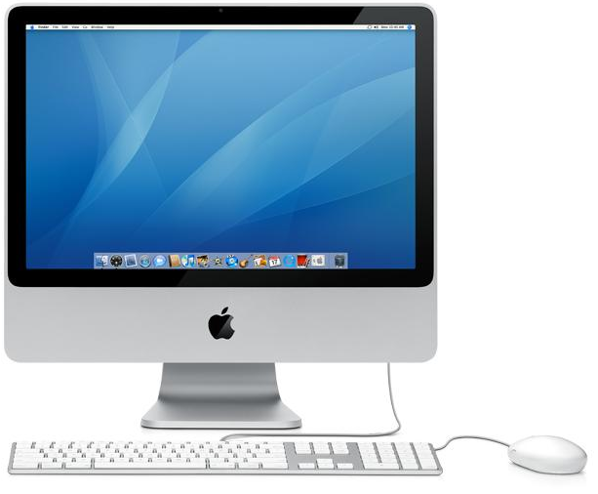
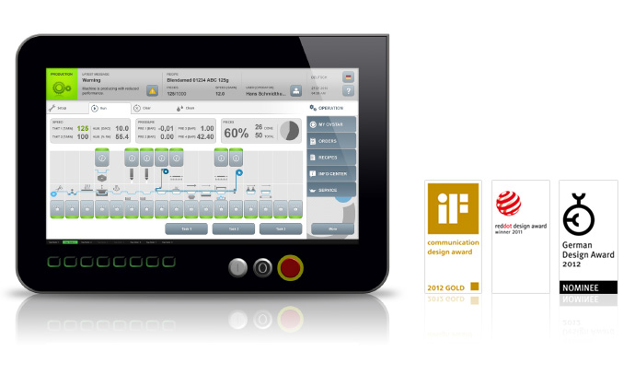

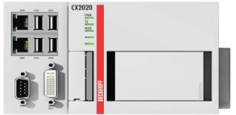
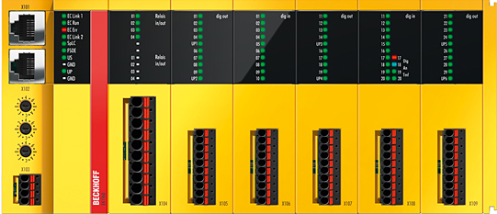
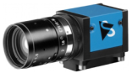
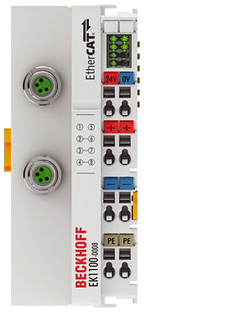
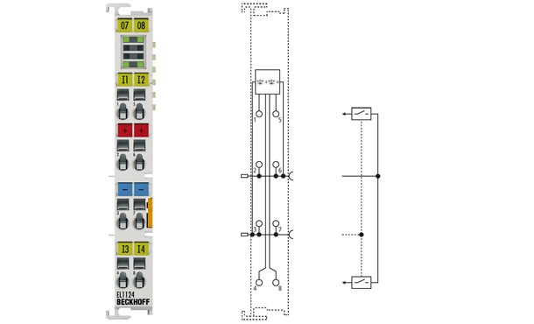
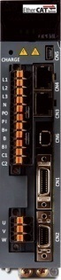
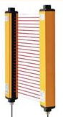
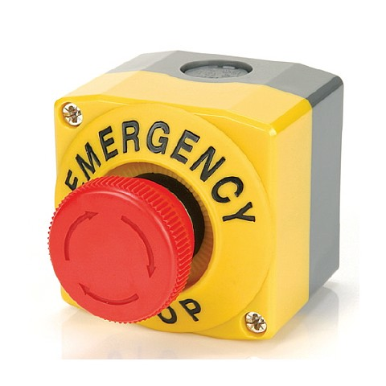
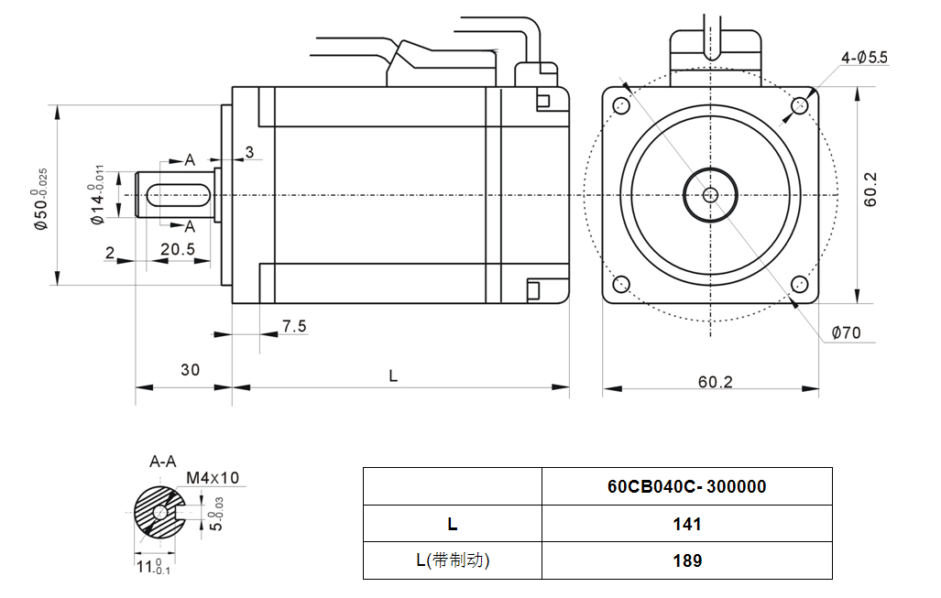
System network (Low)
Management
Layer
Host PC with OSX or Windows
HMI / Panel
SPC
Ethernet
TCP/IP
Vision System
PLC/ Motion Control:
Beckhoff→ TwinCAT
Berghof→ CoDeSys
Leadshine
Inovance
Trio
Googol
Safety Control
Control Layer
Fieldbus:
EtherCAT
CANbus
Modbus
Profibus
Profinet
Sercos III
Safety loop
Device Layer
Smart Vision
Remote I/O
Drive and Motor
Safety Device

Slide 6
Example 1

Slide 7
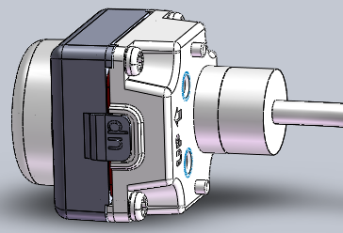
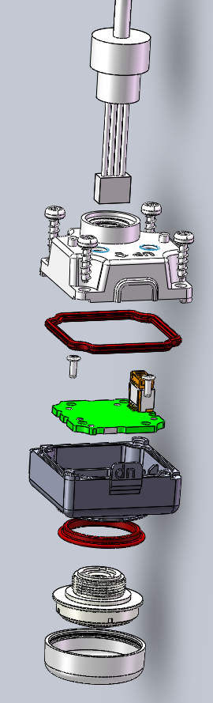
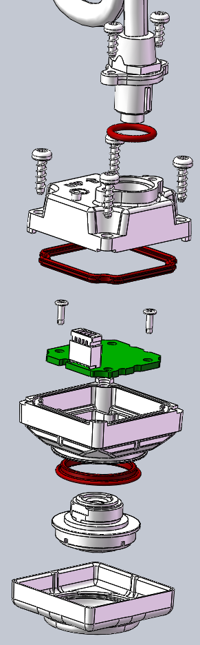
1. 产品结构
示例样品
前罩
LENS
PCBA
PCBA螺丝
后盖螺丝
尾线螺丝
尾线防水圈
LENS 防水圈
后盖防水圈
前盖
后盖
尾线连接器

Slide 8
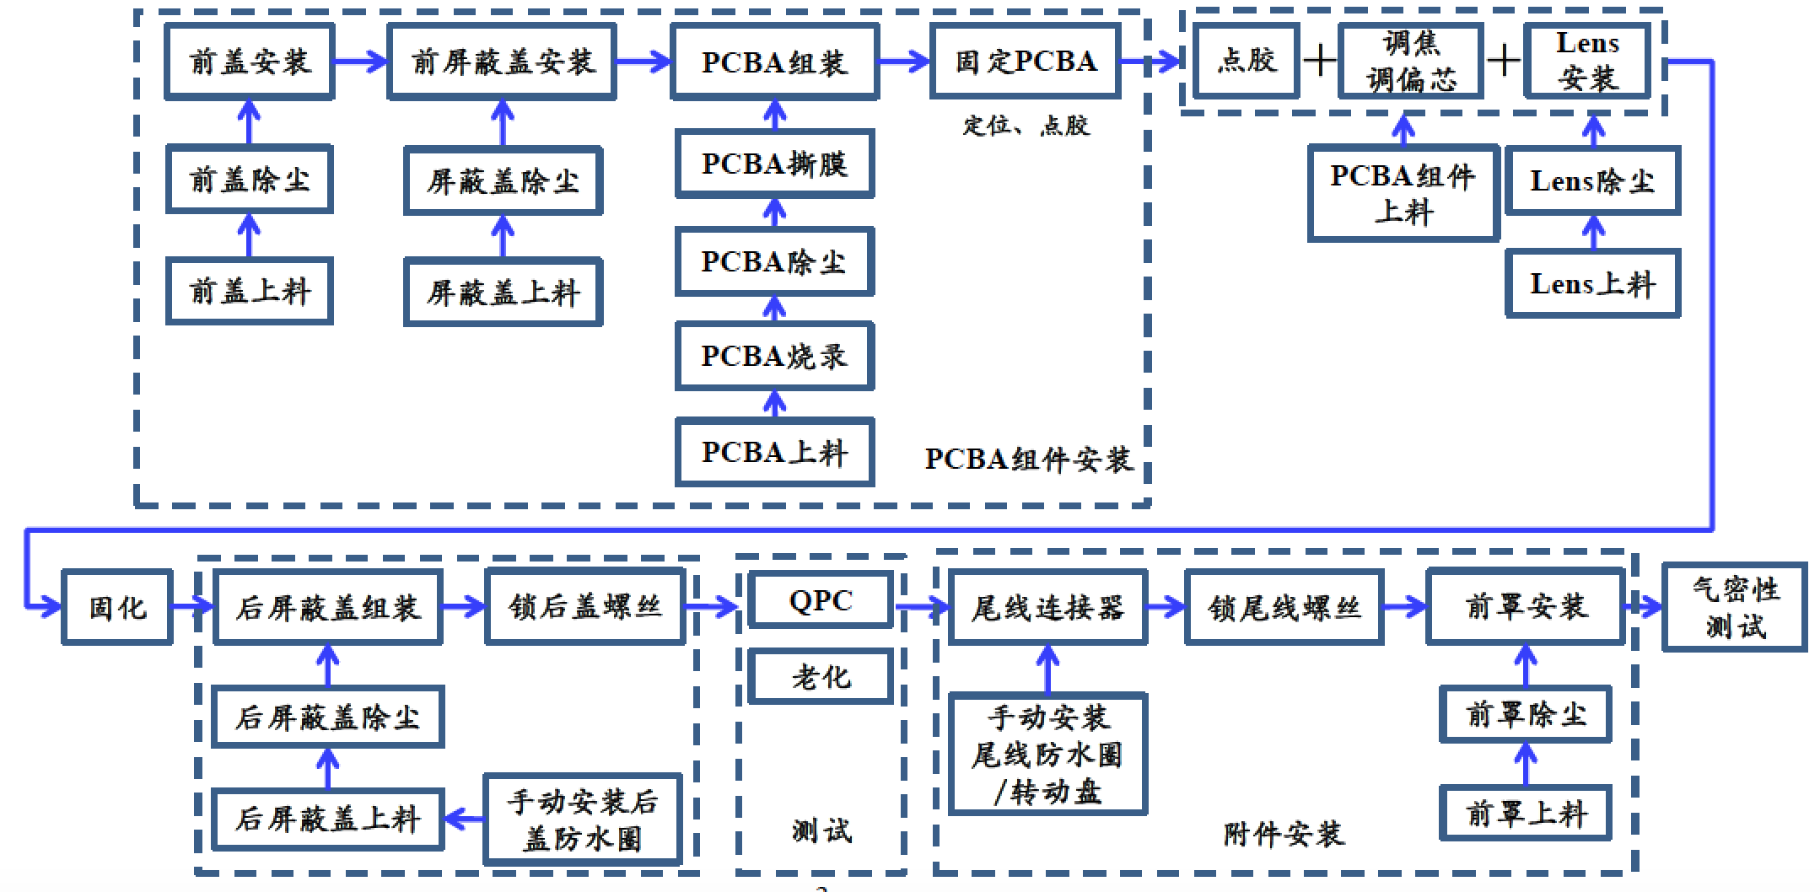
2. 工艺流程

Slide 9
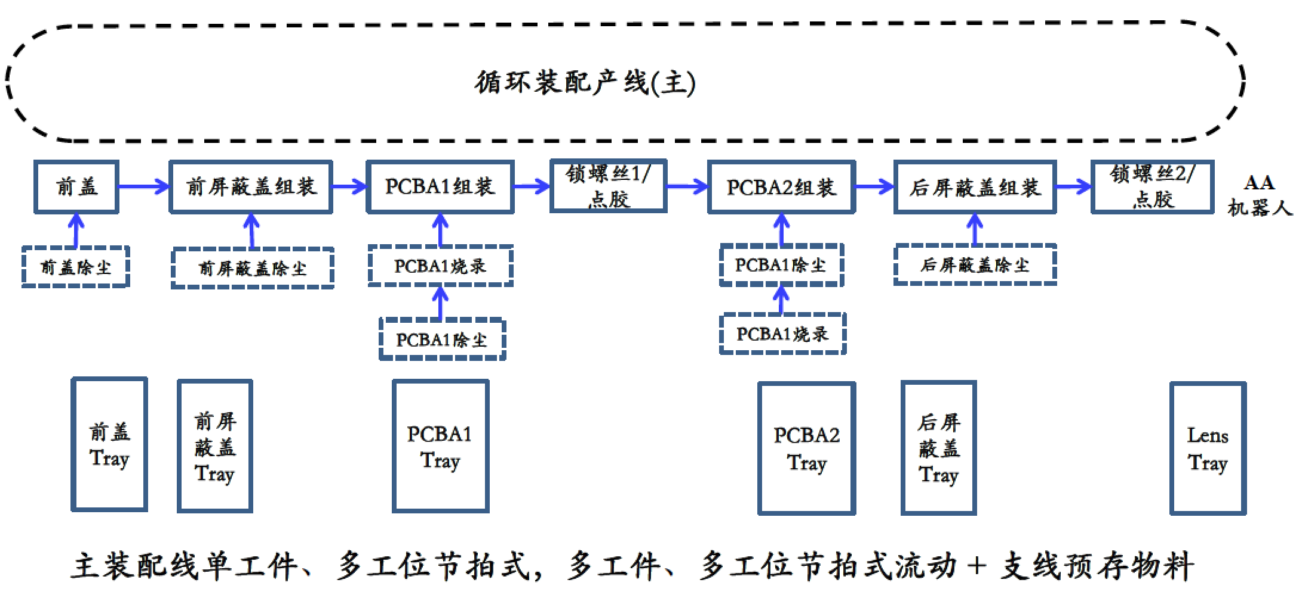
3. 产品输送

Slide 10
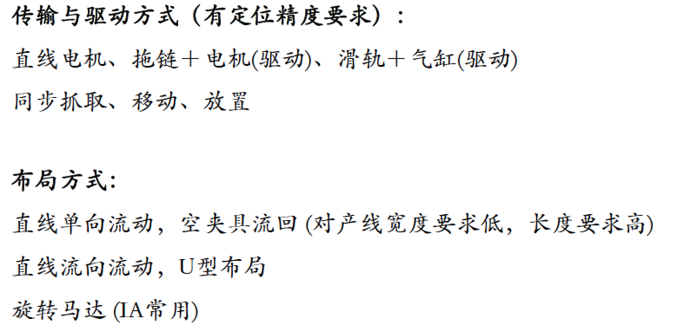
3. 产品输送－可选方案

Slide 11
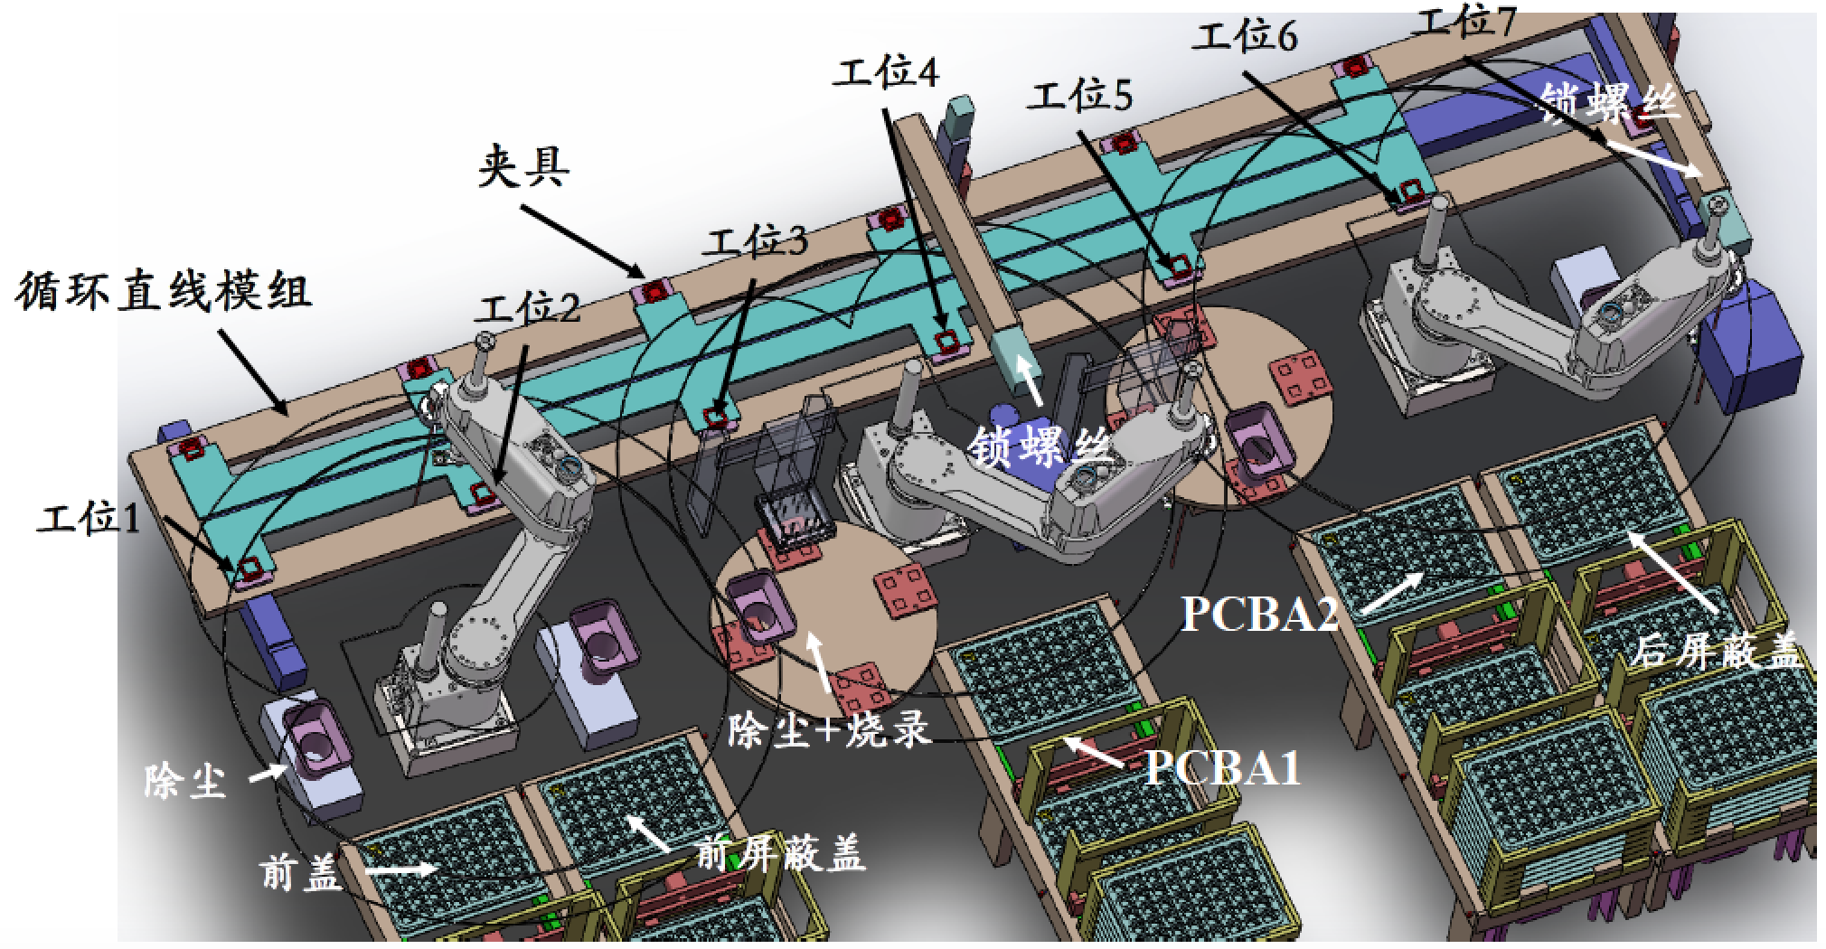
4. 布局

Slide 12
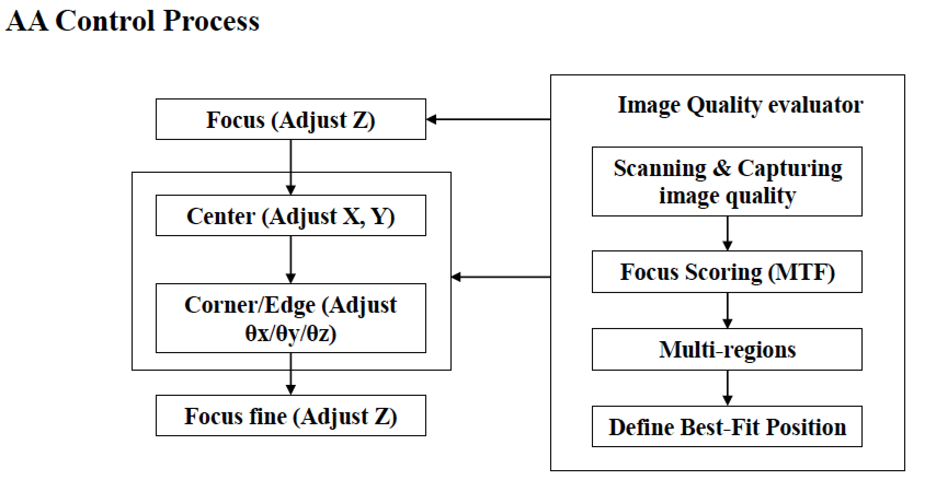
5. 关键工位分析1

Slide 13
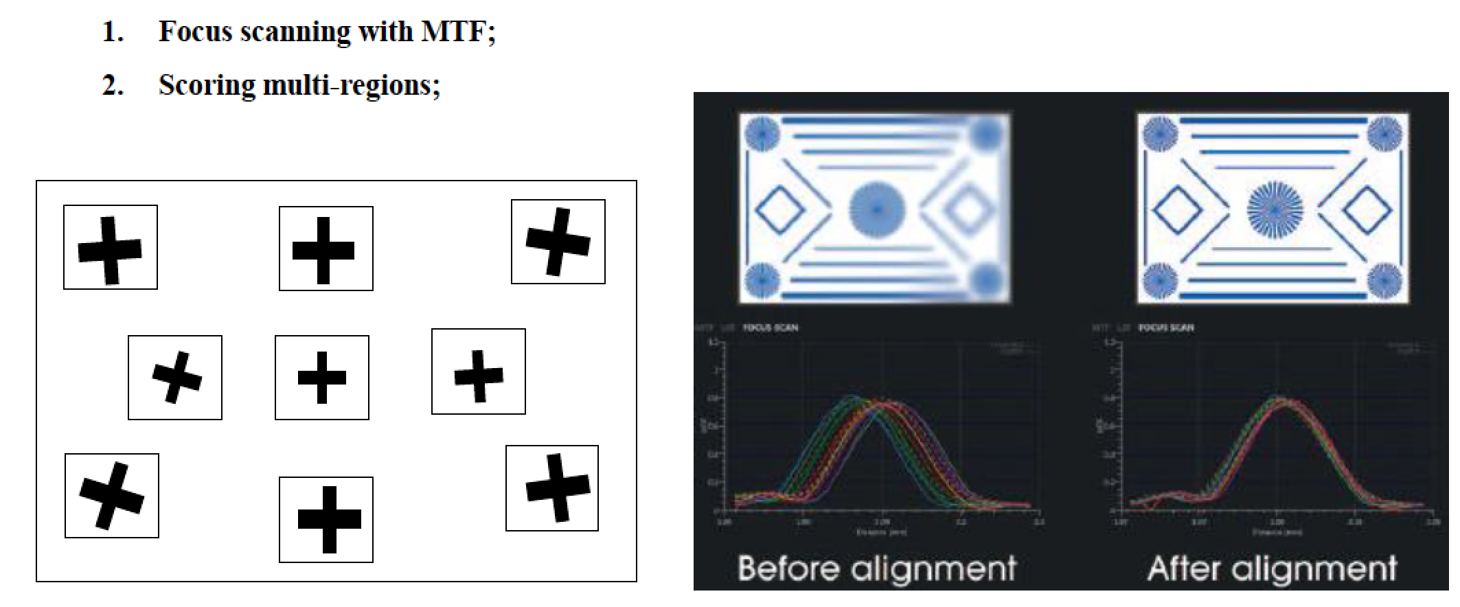
5. 关键工位分析2

Slide 14
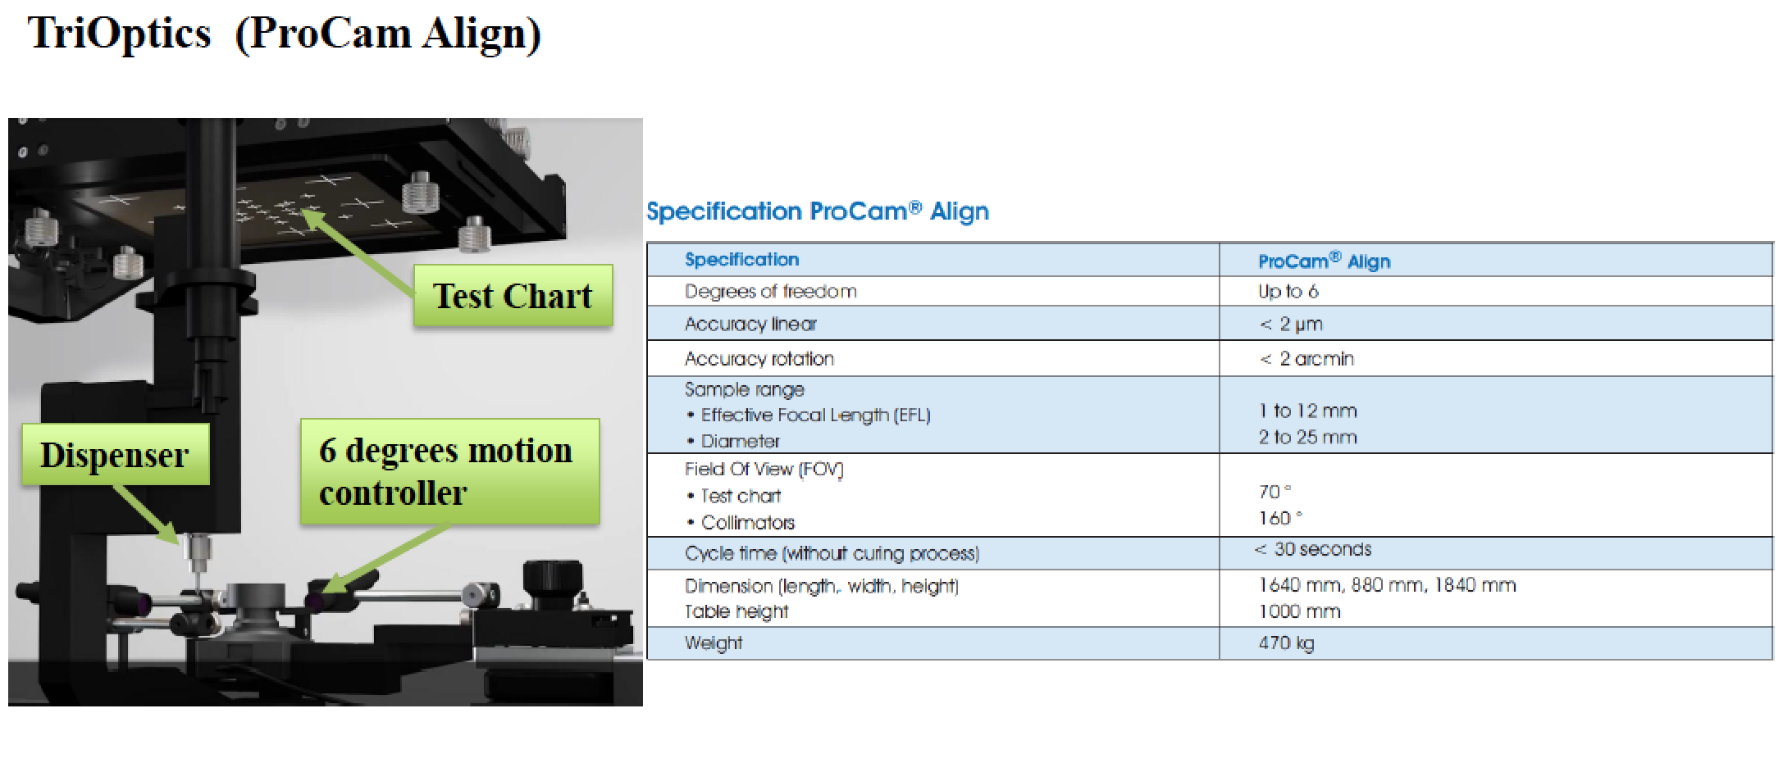
5. 关键工位分析3

Slide 15
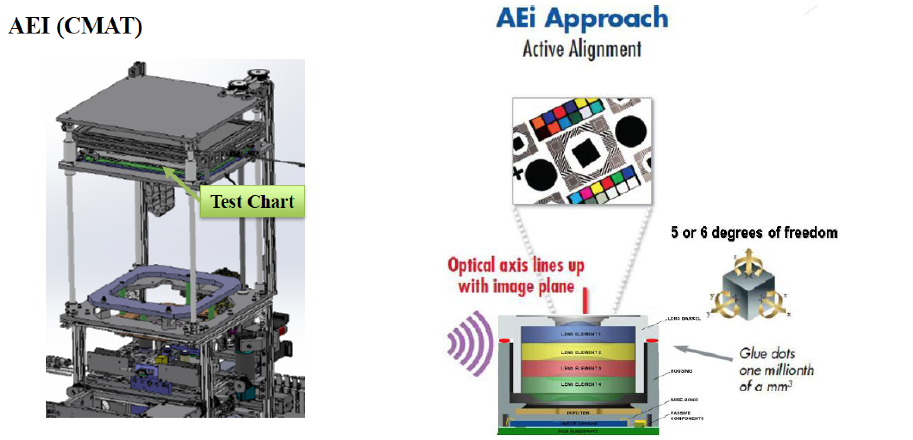
5. 关键工位分析4

Slide 16
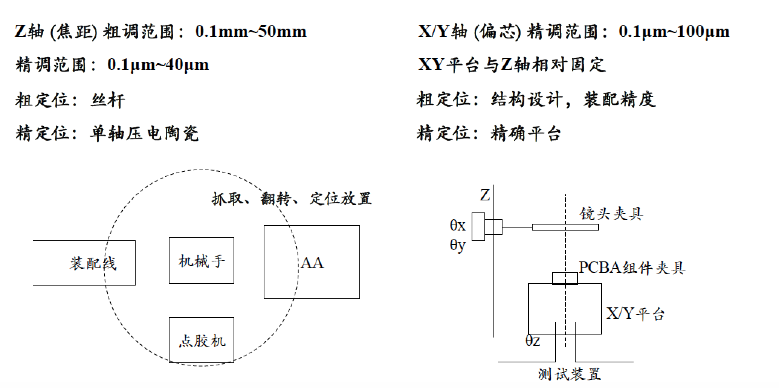
5. 关键工位分析5

Slide 17
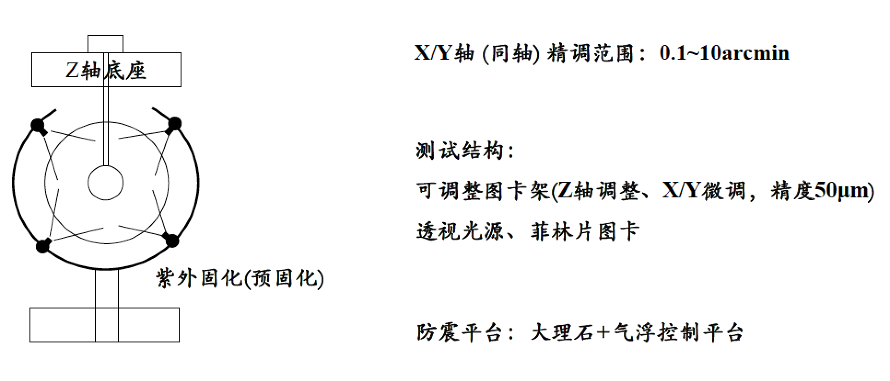
5. 关键工位分析6

Slide 18
Example 1
End

Slide 19
Automation System
Automated machine tools
Transfer lines
Automated assembly systems
Industrial robots
Automated material handling and storage systems
Automatic inspection systems for quality control

Slide 20
Automation Types
Programmable
Automation
Variety
Flexible
Automation
Fixed
Automation
Quantity

Slide 21
Fixed Automation
Sequence of processing (or assembly) operations is fixed by the equipment configuration
Typical features:
Suited to high production quantities
High initial investment for custom-engineered equipment
High production rates
Relatively inflexible in accommodating product variety

Slide 22
Flexible Automation
System is capable of changing over from one job to the next with little lost time between jobs
Typical features:
High investment for custom-engineered system
Continuous production of variable mixes of products
Medium production rates
Flexibility to deal with soft product variety

Slide 23
Programmable Automation
Capability to change the sequence of operations through reprogramming to accommodate different product configurations
Typical features:
High investment in programmable equipment
Lower production rates than fixed automation
Flexibility to deal with variations and changes in product configuration
Most suitable for batch production
Physical setup and part program must be changed between jobs (batches)

Slide 24
Automation Principle
Understand the existing process
Input/output analysis
Value chain analysis
Charting techniques and mathematical modeling
Simplify the process
Reduce unnecessary steps and moves
Automate the process
Ten strategies for automation and production systems
Automation migration strategy

Slide 25
Automation Strategies
Specialization of operations （定制化）
Combined operations （整合化）
Simultaneous operations （同步化）
Integration of operations （集成化）
Increased flexibility （柔性）
Improved material handling and storage （改善物流）
On-line inspection （在线检测）
Process control and optimization （工艺优化）
Plant operations control （设备操作控制工厂级或车间级）
Computer-integrated manufacturing （计算机即成制造）

Slide 26
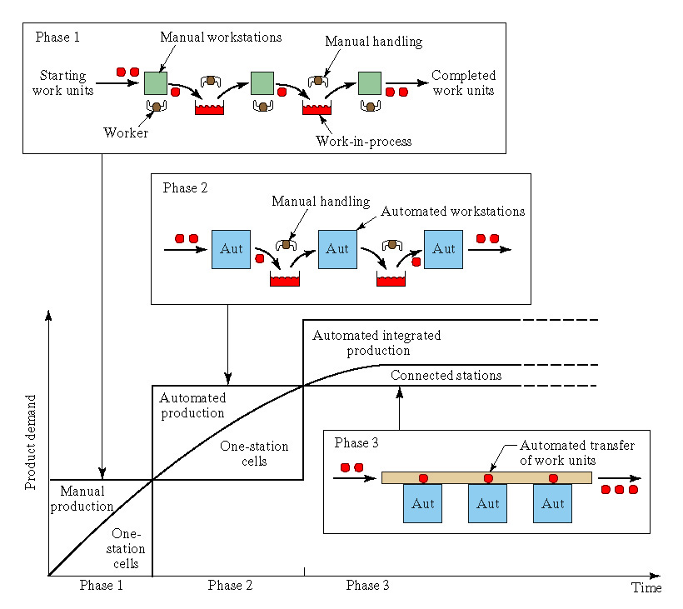
Migration Strategy

Slide 27
Automation Topic
Definition of Industrial Automation
Mathematical Models for Manufacturing
Industrial Systems
Control Systems
Sensors and Actuators
Automated Machine Tools
Industrial Robotics
Logic Controllers
Handling Systems
Storage Systems
Identification Systems
Manufacturing Cells
Assembly Lines
Flexible Manufacturing Systems

Slide 28
Simple technical concept

Slide 29
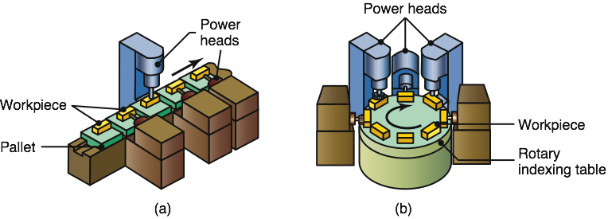
Transfer Mechanisms
FIGURE 14.4 Two types of transfer mechanisms: (a) straight, and (b) circular patterns.

Slide 30
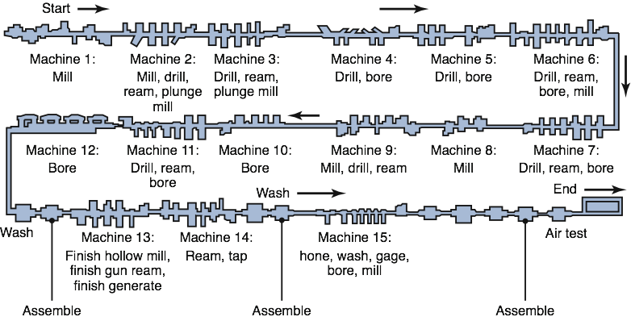
Transfer Line
FIGURE 14.5 A traditional transfer line for producing engine blocks and cylinder heads. Source: Ford Motor Company.

Slide 31
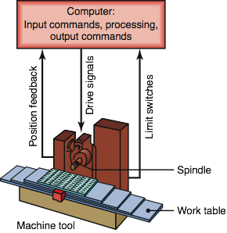
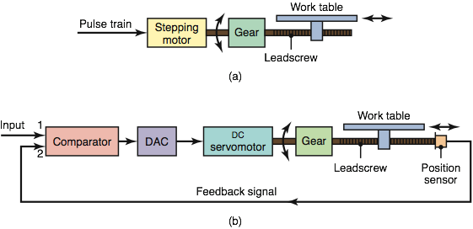
Numerical Control
FIGURE 14.7 Schematic illustration of the major components of a numerical control machine tool.
FIGURE 14.8 Schematic illustration of the components of (a) an open-loop, and (b) a closed-loop control system for a numerical control machine. (DAC is digital-to-analog converter.)

Slide 32
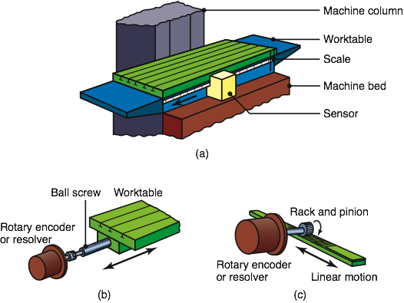
Displacement Measurement
FIGURE 14.9 (a) Direct measurement of the linear displacement of a machine-tool worktable. (b) and (c) Indirect measurement methods.

Slide 33
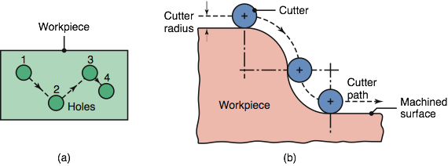
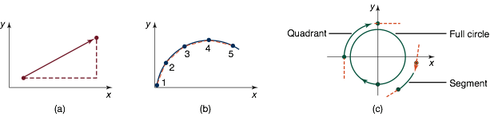
Tool Movement & Interpolation
FIGURE 14.10 Movement of tools in numerical control machining. (a) Point-to-point system: The drill bit drills a hole at position 1, is then retracted and moved to position 2, and so on. (b) Continuous path by a milling cutter; note that the cutter path is compensated for by the cutter radius. This path can also compensate for cutter wear.
FIGURE 14.11 Types of interpolation in numerical control: (a) linear; (b) continuous path approximated by incremental straight lines; and (c) circular.

Slide 34
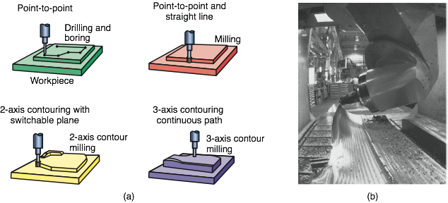
CNC Operations
FIGURE 14.12 (a) Schematic illustration of drilling, boring, and milling operations with various cutter paths. (b) Machining a sculptured surface on a five-axis numerical control machine. Source: The Ingersoll Milling Machine Co.

Slide 35
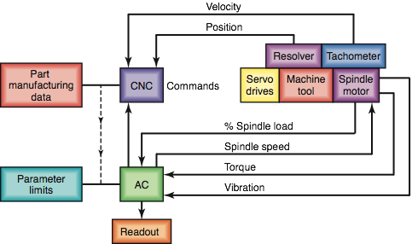
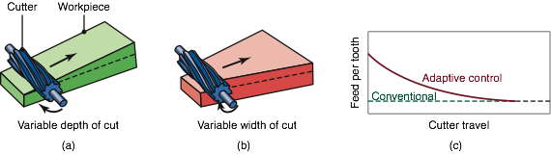
Adaptive Control
FIGURE 14.13 Schematic illustration of the application of adaptive control (AC) for a turning operation. The system monitors such parameters as cutting force, torque, and vibrations; if they are excessive, AC modifies process variables, such as feed and depth of cut, to bring them back to acceptable levels.
FIGURE 14.14 An example of adaptive control in slab milling. As the depth of cut or the width of cut increases, the cutting forces and the torque increase; the system senses this increase and automatically reduces the feed to avoid excessive forces or tool breakage. Source: After Y. Koren.

Slide 36
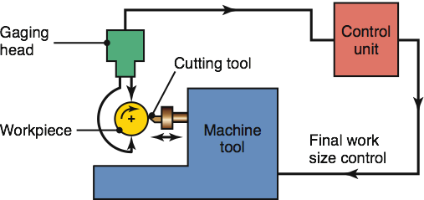
In-Process Inspection
FIGURE 14.15 In-process inspection of workpiece diameter in a turning operation. The system automatically adjusts the radial position of the cutting tool in order to machine the correct diameter.

Slide 37
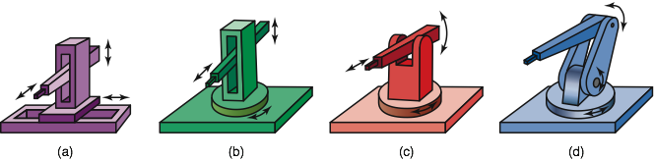
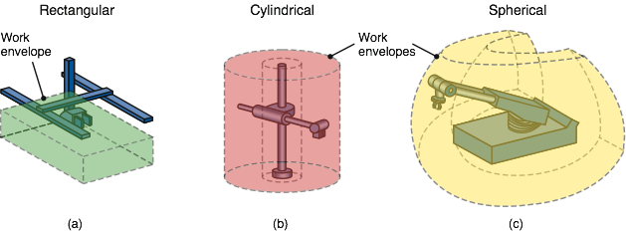
Robot Types & Workspaces
FIGURE 14.19 Four types of industrial robots: (a) Cartesian (rectilinear); (b) cylindrical; (c) spherical (polar); and (d) articulated, (revolute, jointed, or anthropomorphic). Some modern robots are anthropomorphic, meaning that they resemble humans in shape and in movement. These complex mechanisms are made possible by powerful computer processors and fast motors that can maintain a robot's balance and accurate movement control.
FIGURE 14.20 Work envelopes for three types of robots. The selection depends on the particular application (See also Fig. 14.17b.)

Slide 38
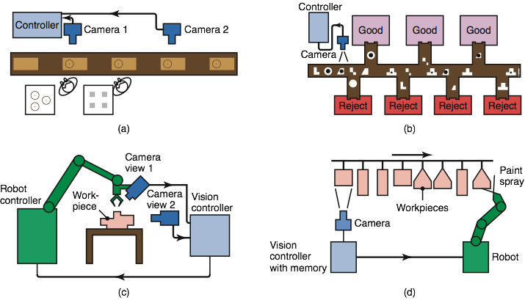
Applications of Machine Vision
FIGURE 14.26 Examples of machine vision applications. (a) In-line inspection of parts. (b) Identifying parts with various shapes, and inspection and rejection of defective parts. (c) Use of cameras to provide positional input to a robot relative to the workpiece. (d) Painting of parts with different shapes by means of input from a camera; the system's memory allows the robot to identify the particular shape to be painted and to proceed with the correct movements of a paint spray attached to the end effector.

Slide 39
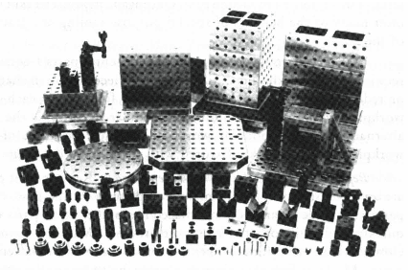
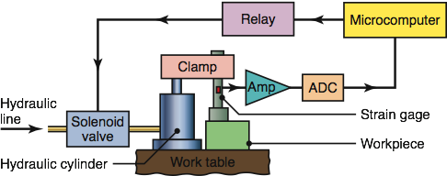
Fixturing
FIGURE 14.28 Schematic illustration of an adjustable-force clamping system. The clamping force is sensed by the strain gage, and the system automatically adjusts this force. Source: After P.K. Wright and D.A. Bourne.
FIGURE 14.27 Components of a modular workholding system. Source: Carr Lane Manufacturing Co.

Slide 40
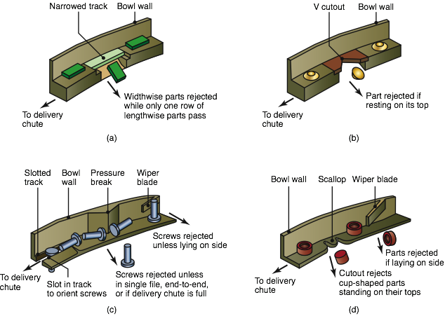
Vibratory Feeder Guides
FIGURE 14.31 Examples of guides to ensure that parts are properly oriented for automated assembly. Source: After G. Boothroyd.

Slide 41
End

